Slide 1
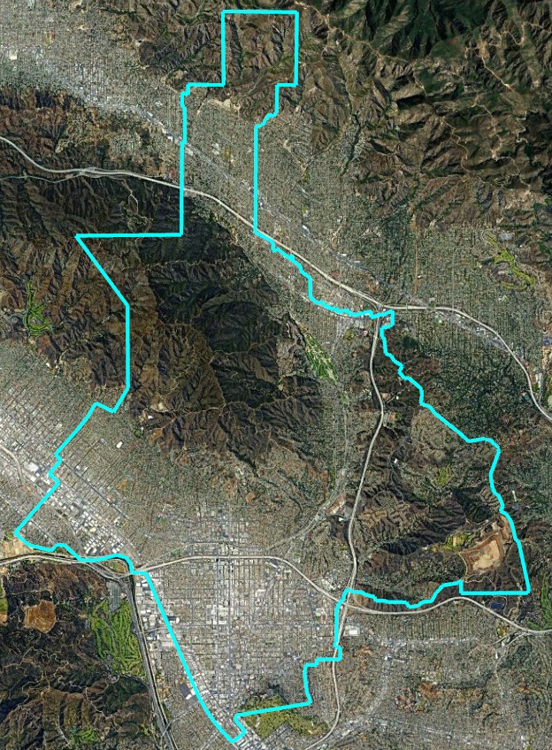
City of Glendale Introduction to Districting
Douglas Johnson, National Demographics Corporation Sydni Overly, Tripepi Smith

Slide 2
Introductions

Slide 3
Today’s Goals
You Learn from the Experts
Experts Listen to You
Mapping Tools Overview
You Leave Empowered to Give Effective Feedback

Slide 4
Why You Should Care
Democracy works better when people are engaged
You are the experts on your community
You are the experts on your neighborhood
The districts determined in this process will be around until 2031

Slide 5
Presentation Overview
Background: The Districting Process
Legal Requirements for Districts
Demographic Profile of Glendale
Community of Interest Discussion
Public Mapping Tools
Q&A
How to Stay Engaged
Today’s Goal: You leave empowered to participate effectively in the districting process

Slide 6
The Districting Process
Step | Description
1st Council Hearing June 13 | Held prior to release of draft maps. Education and to solicit input on the composition of districts.
1st Round of Community Forums | First round: 1 virtual workshop, 6 in-person workshops + pop-up events. Beginning June 13 through July 27
2nd Council Hearing July 11 | Very similar presentation to the first hearing, but with a summary of feedback from the forums. Council opportunity to give direction to NDC.
Initial Deadline for the public to submit maps August 5 | Maps must be submitted far enough in advance to allow NDC to download, input and process the maps for posting online before the August 8 posting deadline.
Deadline to post initial draft maps on project website August 8 | Maps must be posted at least 7 days prior to 3rd hearing.
3rd Council Hearing August 15 | First formal public and Council consideration of initial draft maps. Opportunity for Council to select “focus” maps options and to request new or revised maps.
Part 1 of 2

Slide 7
The Districting Process
Step | Description
2nd Round of Community Forums | Second round: 1 virtual workshop, 6 in-person workshops + pop-up events. Beginning August 17 through September 7
Deadline to submit maps September 28 | Maps must be submitted far enough in advance to allow NDC to download, input and process the maps for posting online.
Deadline to post new maps October 3 | Maps must be posted at least 7 days prior to 4th hearing.
4th Council Hearing October 10 | Public & Council to consider “focus” maps and any new or revised maps. Preferred map and election sequence selected and 1st reading of adoption ordinance.
5th Council Hearing and Map Adoption October 24 | Council selects map via ordinance, contingent on voter approval. Final map must be posted at least 7 days prior to adoption.
Citywide Vote March 5, 2024 | Vote on transition to by-district elections on primary and (at-large) City Council election ballot
Part 2 of 2

Slide 8
Districting Rules and Goals
1. Federal Laws
2. California Criteria for Cities
3. Other Traditional Redistricting Principles
Equal Population
Federal Voting Rights Act
No Racial Gerrymandering
Geographically contiguous
Undivided neighborhoods and “communities of interest” (Socio-economic geographic areas that should be kept together)
Easily identifiable boundaries
Compact (Do not bypass one group of people to get to a more distant group of people)
Prohibited:
“Shall not favor or discriminate against a political party.”
Respect voters’ choices / continuity in office
Future population growth

Slide 9
Demographic Summary
Each of the 6 districts must contain about 32,830 people.

Slide 10
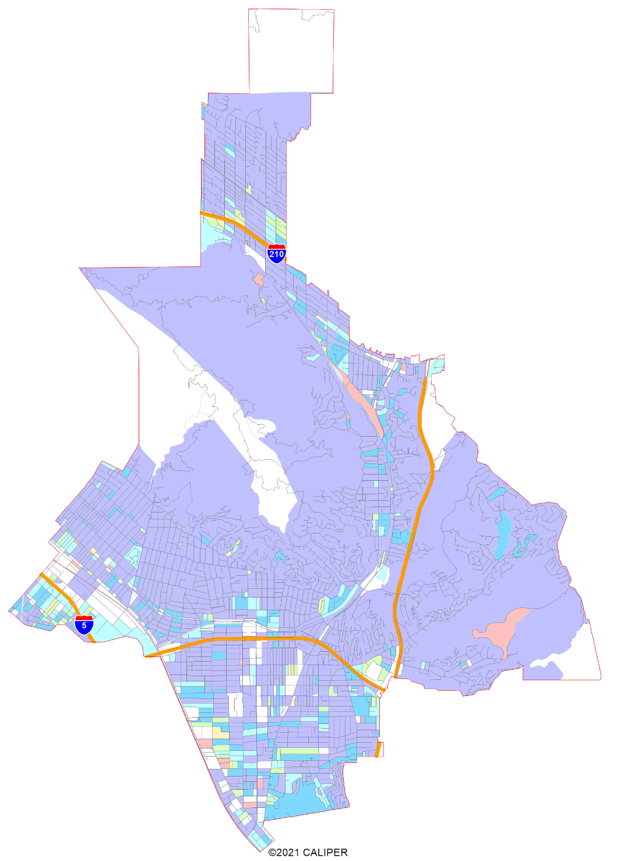
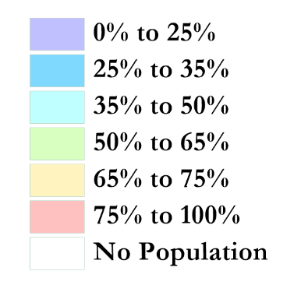
Latino CVAP
Latinos are somewhat more concentrated along the I-5 corridor and Los Angeles City border.

Slide 11
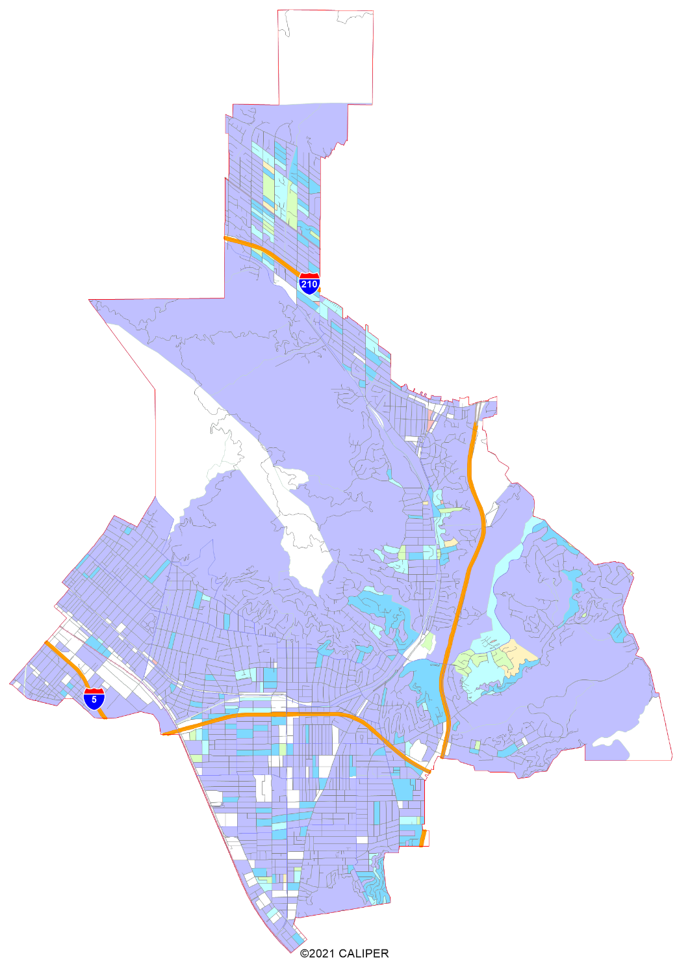
Asian-American CVAP
Asian-Americans concentrated in the north and Rancho San Rafael.

Slide 12
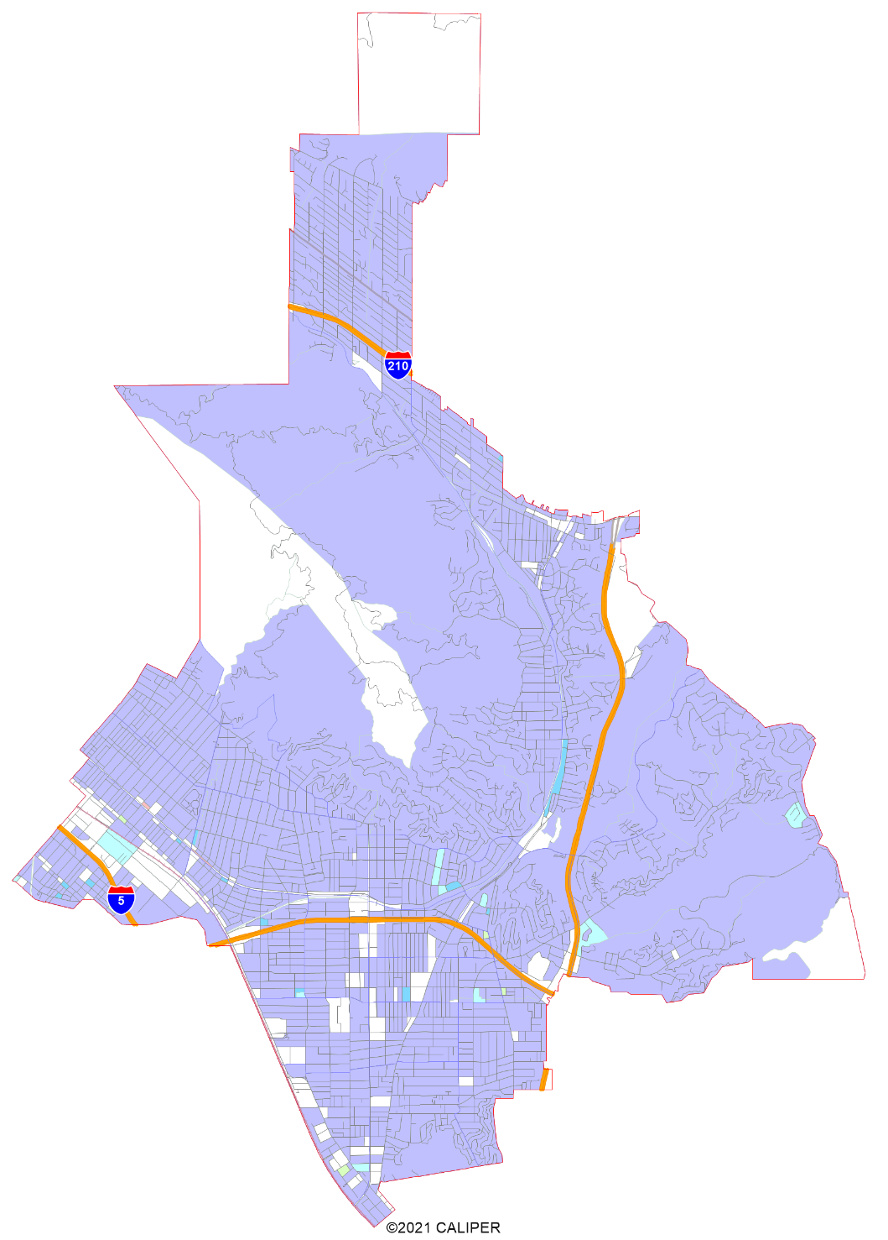
African-American CVAP
African-Americans are not geographically concentrated in any specific part of the City.

Slide 13
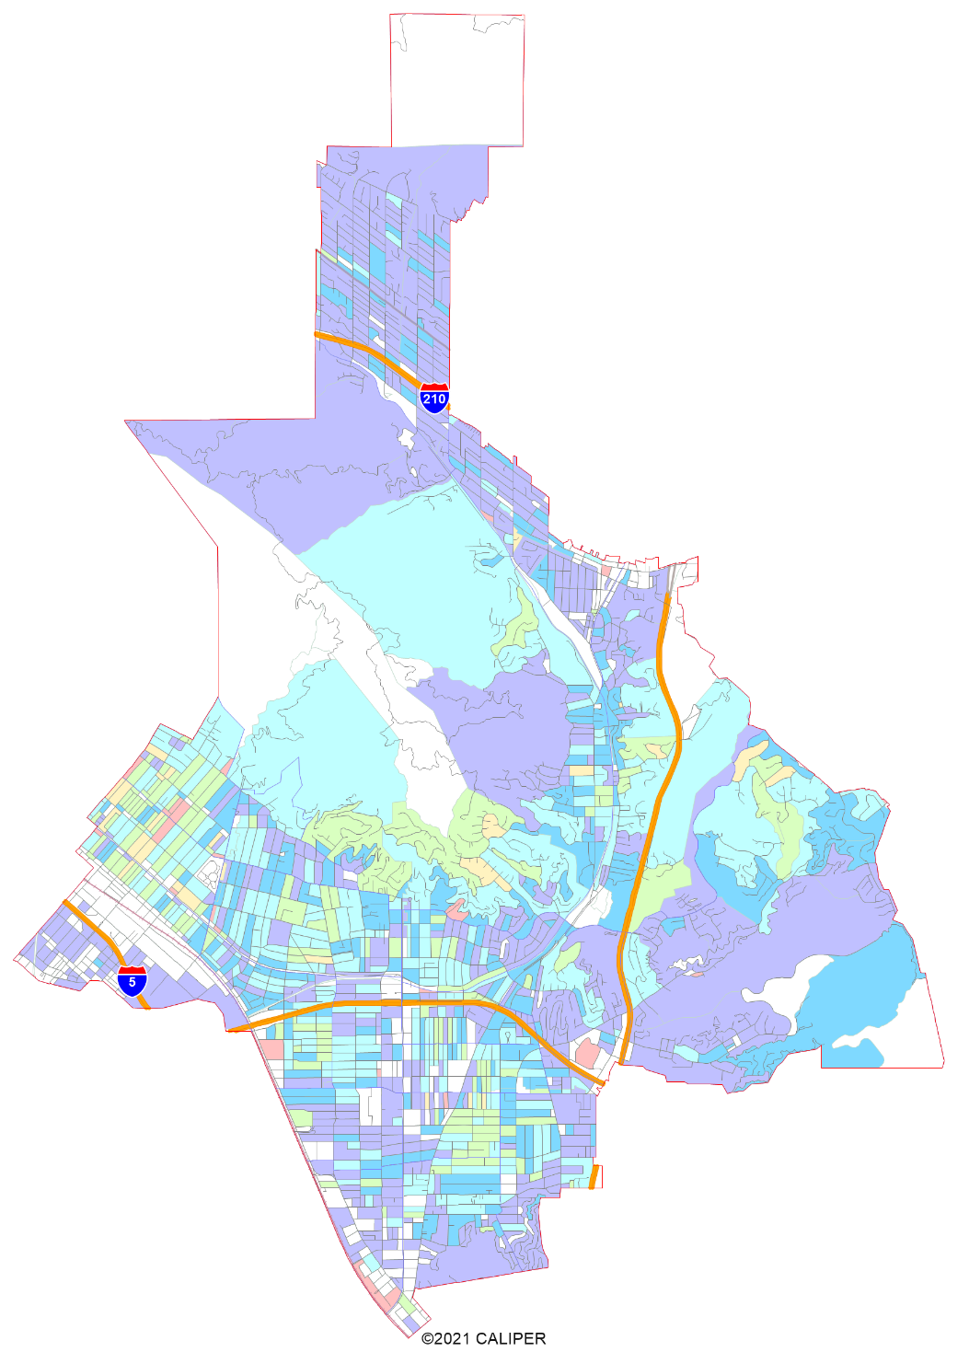
Community of Interest: Armenian % of Registered Voters
Data from PDI.

Slide 14
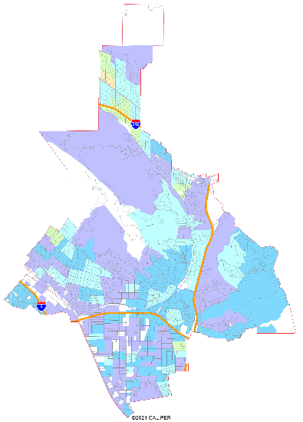
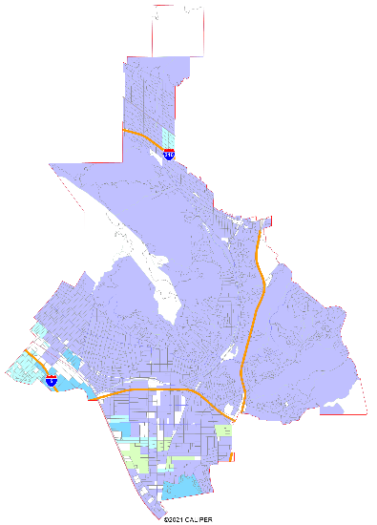
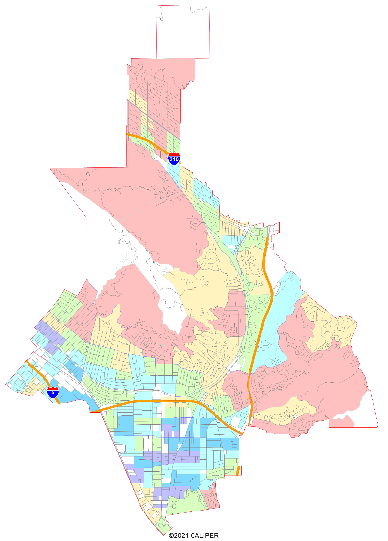
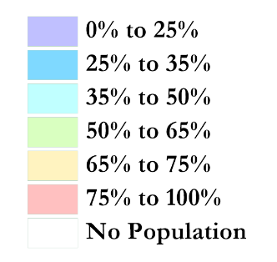
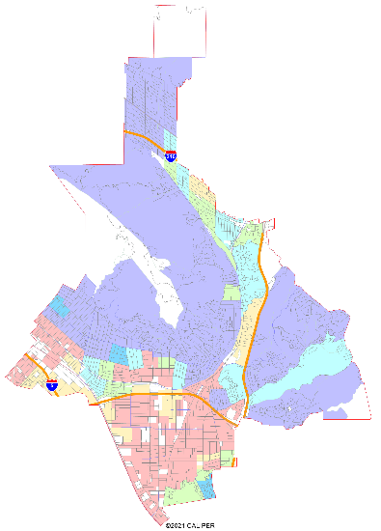
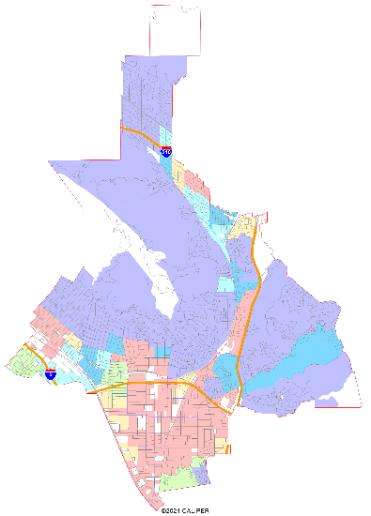
Other Potential Communities of Interest: Socio-Economic Demographics
Child at home
Spanish spoken at home
Household income over $75,000 / yr.
Multi-Family Housing (Apartments or Condos)
Renters

Slide 15
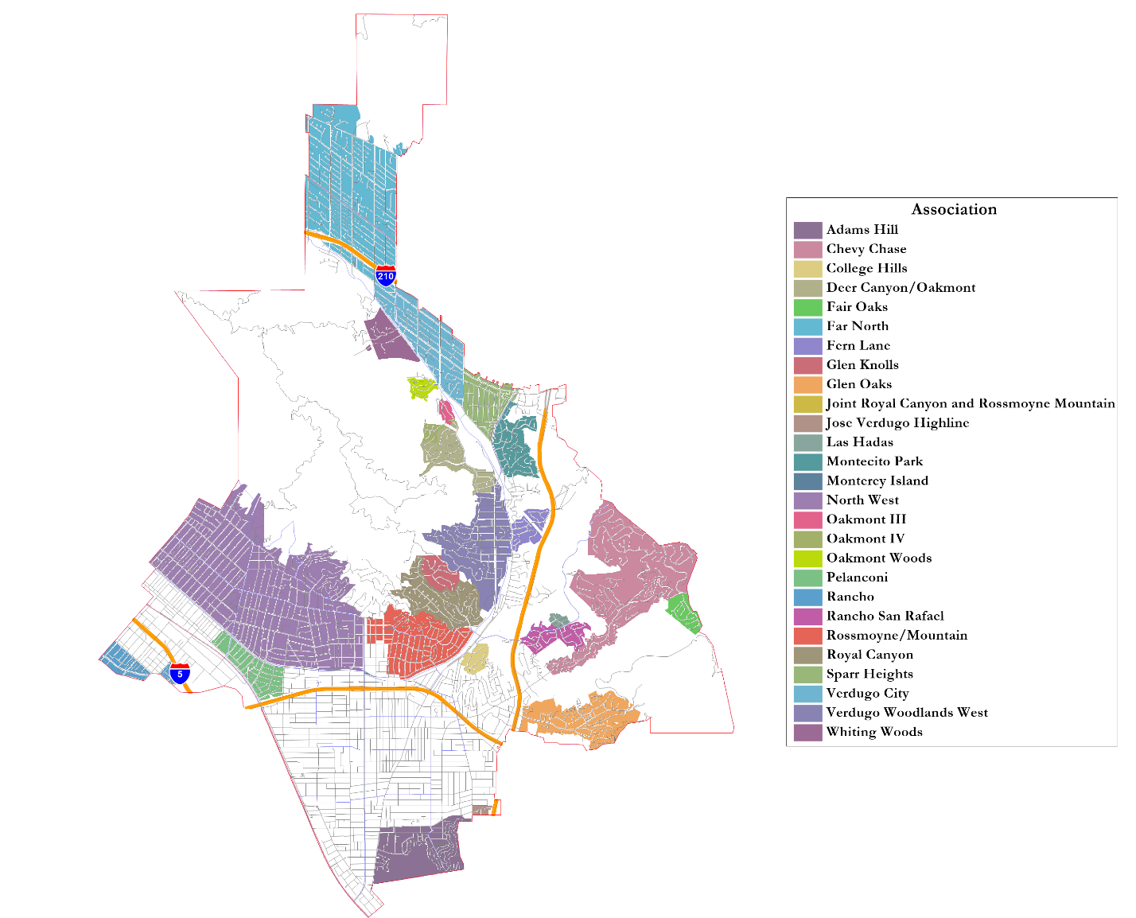
Other Possible Geographic Communities (1)
Homeowner Associations

Slide 16
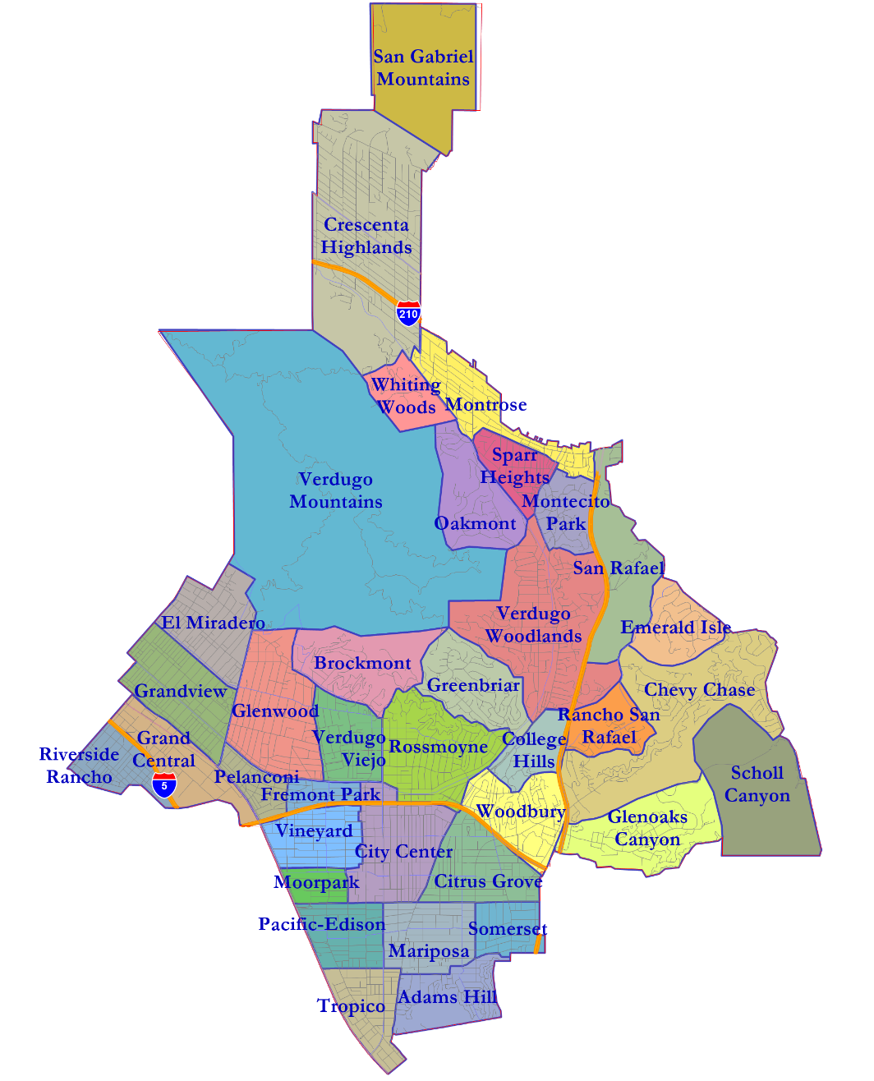
Other Possible Geographic Communities (2)
Unofficial Rough Neighborhoods

Slide 17
Defining Neighborhoods
1st Question: What is your neighborhood?
2nd Question: What are its geographic boundaries?
Examples of physical features defining a neighborhood boundary:
Natural neighborhood dividing lines, such as highway or major roads, rivers, canals and/or hills
Areas around parks or schools
Other neighborhood landmarks
In the absence of public testimony, planning records and other similar documents may provide definition.

Slide 18
Beyond Neighborhoods: Defining Communities of Interest
1st Question: What defines your community?
Geographic Area, plus
Shared issue or characteristic
Shared social or economic interest
Impacted by city policies
Tell us “your community’s story”
2nd Question: Would this community benefit from being “included within a single district for purposes of its effective and fair representation”?
Or would it benefit more from having multiple representatives?
Definitions of Communities of Interest may not include relationships with political parties, incumbents, or political candidates.

Slide 19
Community of Interest Input
From the June 21 community workshop:
Crescenta Highlands and the Far North
Verdugo mountains
Glendale Unified School District
Glendale Community College

Slide 20
Your Turn – Communities of Interest
Who is part of your community?
What are some meaningful places your community recognizes or gathers at?
What are some common concerns you share with a group?
What are some common cultural characteristics that unite a community?
What are common work-related traits that bring a community together?
What is significant about the physical environment?
What areas benefit from staying together in a district?
Your thoughts will become part of the record.

Slide 21
Public Mapping and Map Review Tools
Different tools for different purposes
Different tools for different levels of technical skill and interest
Simple “review draft maps” tool
Paper-based simple “Draw a draft map” tool
Powerful, data-rich “Draw a draft map” online tool
Whether you use the online mapping tool, the paper kit, or
just draw on a napkin, we welcome your maps!

Slide 22
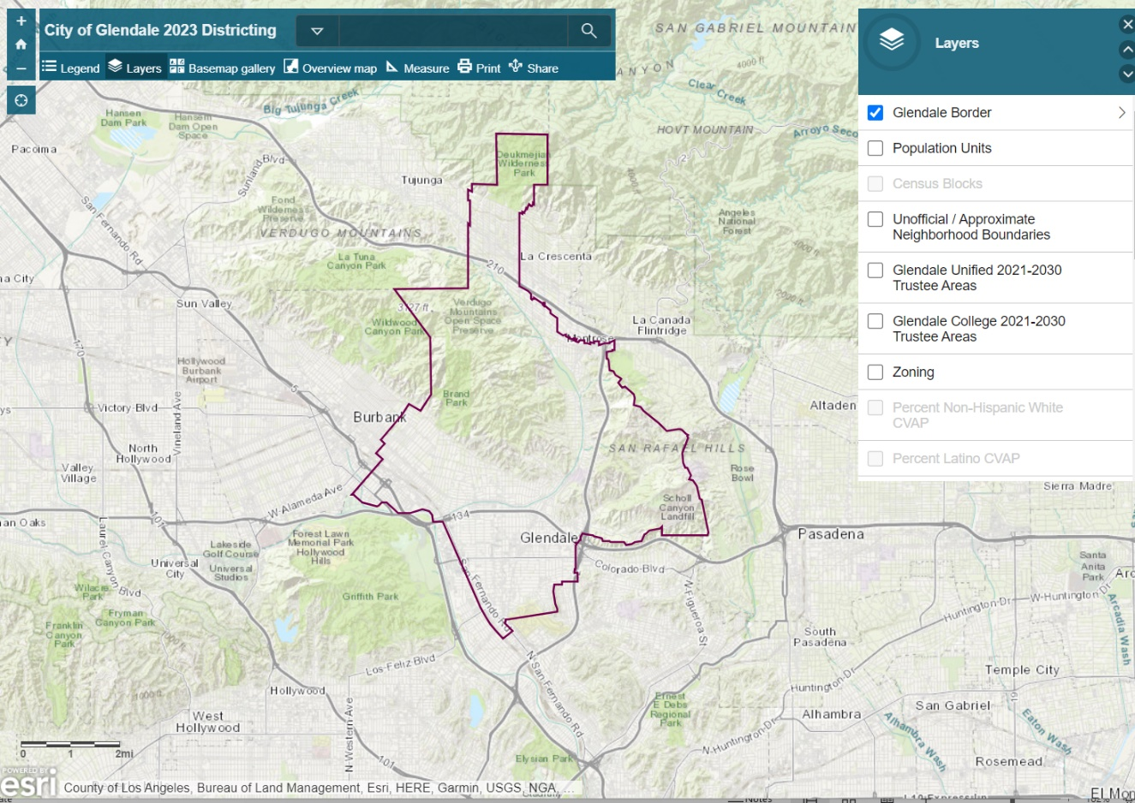
Interactive Review Map
For Viewing Maps, not Drawing Them
Demographic data
Population Unit details
Zoom in and out
Search by address
View (and overlay) draft maps, when available

Slide 23
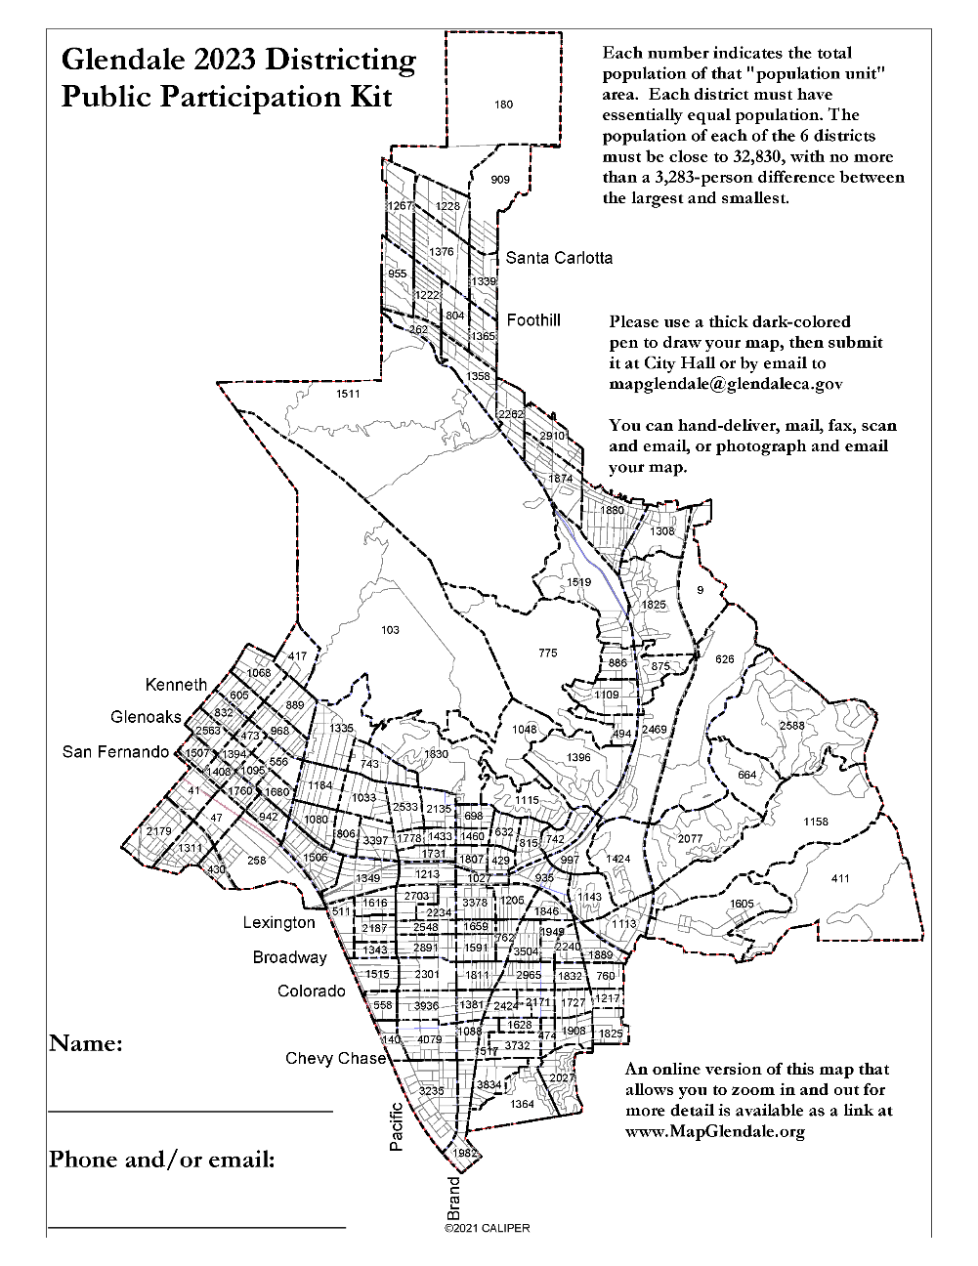
Simple Map Drawing Tool
Paper “Public Participation Kit”
For those without internet access or who prefer paper
Total Population Counts only – no demographic details

Slide 24
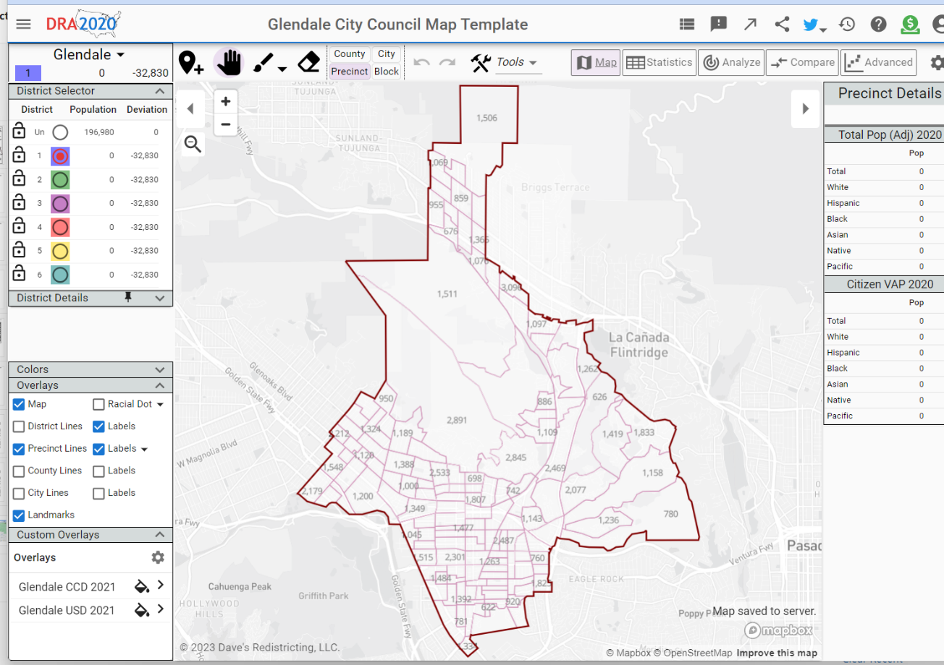
DRA (Dave’s Redistricting App)
Draw Your Community of Interest or a Full District Map
Easy-to-use online mapping tool
Full demographic and geographic database
Email a link to your map to the City and publish or share

Slide 25
Q&A With Your Hosts

Slide 26
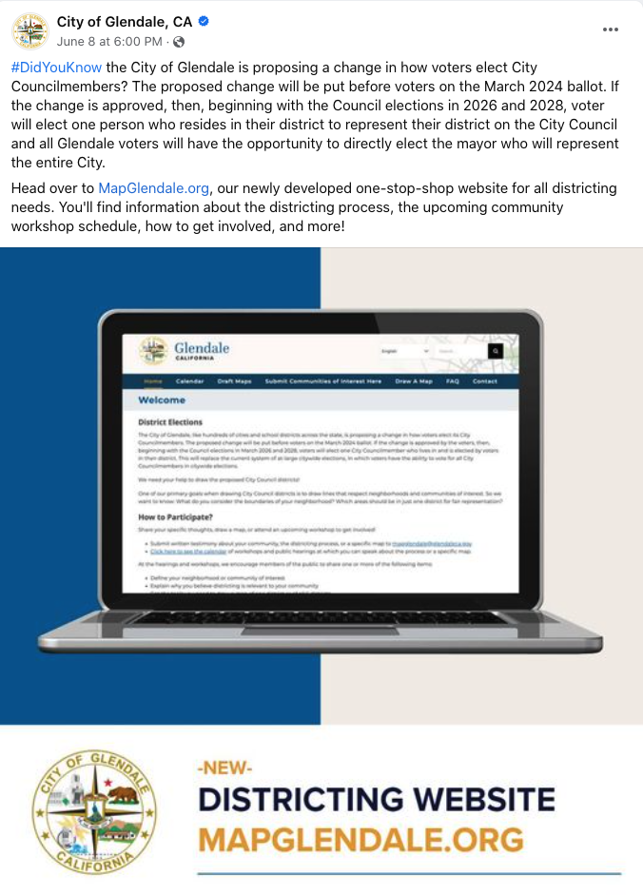
How to Stay Engaged
The City is committed to robust outreach and engagement throughout the process, including the following:
Dedicated website: www.mapglendale.org
In-person workshops
Virtual workshops
Pop-up events in the community
Social media (including online ads)
Animated explainer video
Flyers
Community group outreach
Interpretation/translation of materials
Notes:
Next Community Workshop: In-Person at Pacific Park on June 26
Next Public Hearing: Second Public Hearing on July 11

Slide 27
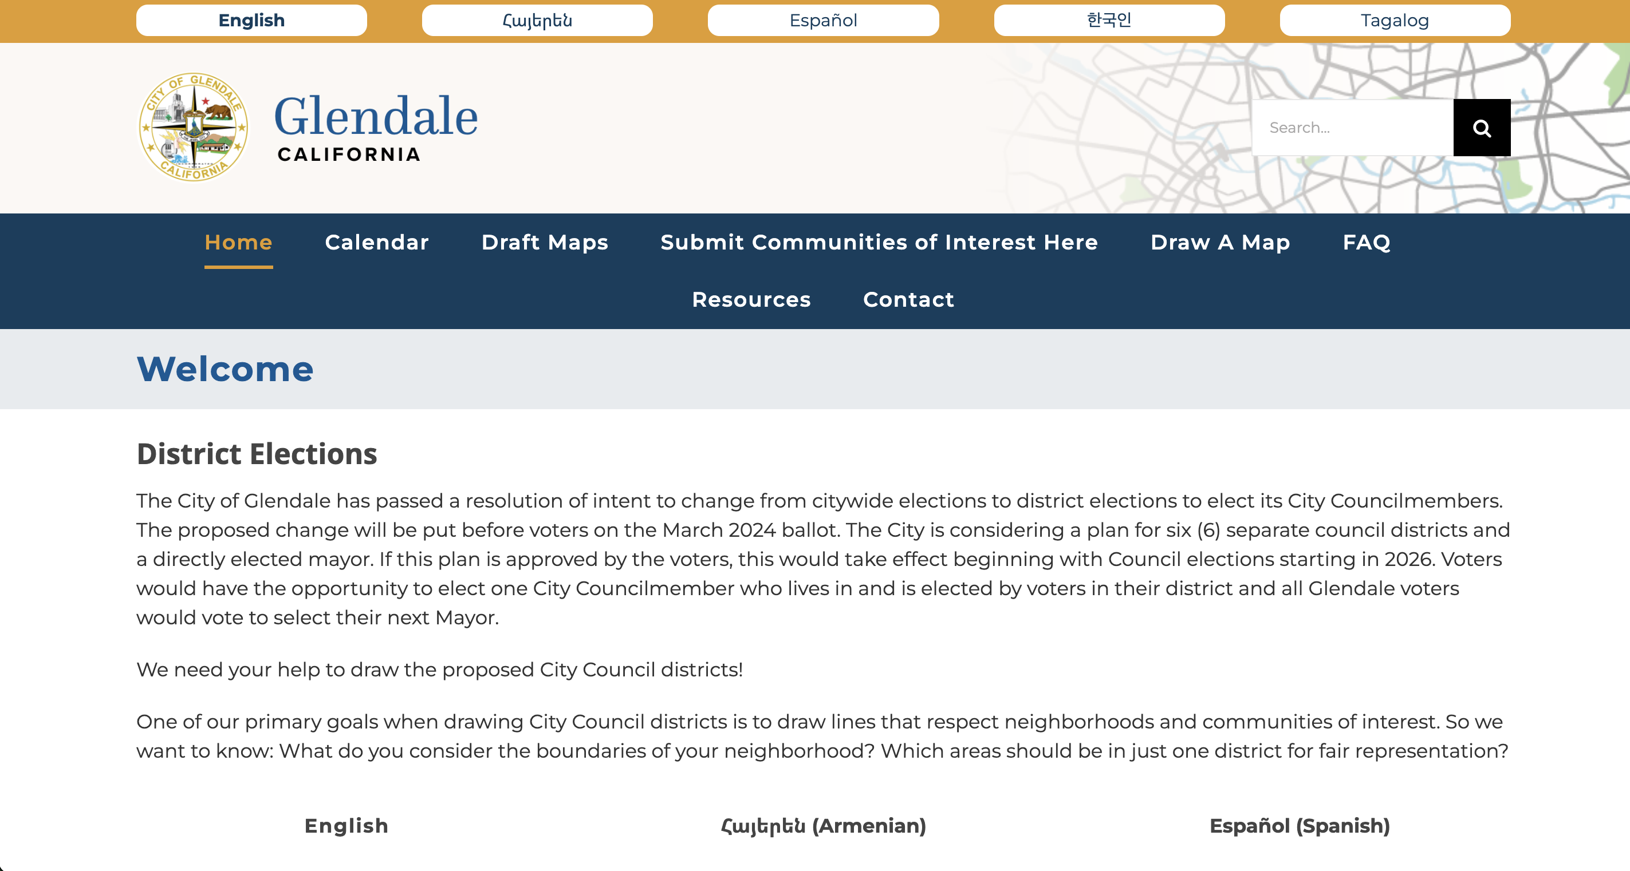
How to Stay Engaged
Website: MapGlendale.org |Phone: (818) 548-4844, ext. 1
Email: mapglendale@glendaleca.gov
Notes:
May update closer to workshop if the buttons are added to the top for translation.

