Slide 1
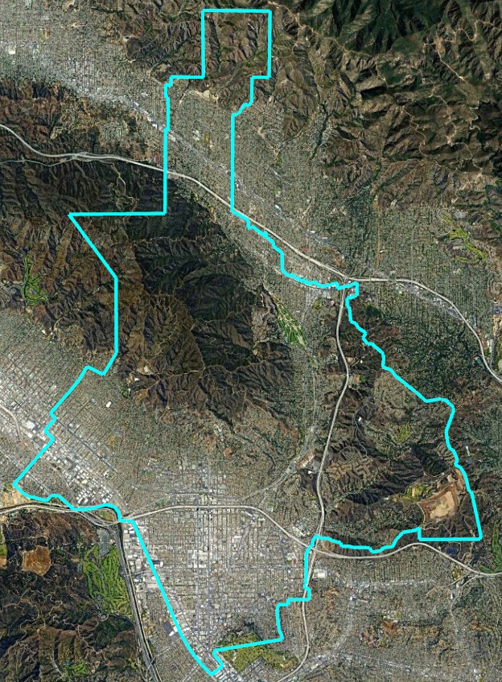
City of Glendale Districting Stakeholder Meeting Results

Slide 2
This Session’s Goals
Review input received during the stakeholder meetings.
Gather your feedback on the map that should be included when voters decide whether to change to by-district elections.

Slide 3
Event | Description
1st Council Hearing June 13, 2023 | Held prior to release of draft maps.
1st Round Public Forums June 13 – July 27 | 1 virtual workshop, 6 in-person workshops + pop-up events.
2nd Council Hearing July 11 | Very similar presentation to the first hearing, but with a summary of feedback from the forums.
3rd Council Hearing August 15 | First formal public and Council consideration of initial draft maps.
2nd Round Public Forums August 17 – September 7 | 1 virtual workshop, 6 in-person workshops + pop-up events.
4th and 5th Council Meetings October 10 and 24 | Public hearing on October 10 and Study Session on October 24
Stakeholder Meetings January 11 – April 8, 2024 | Eight stakeholder meetings completed and one upcoming
Public Forums April 3 and 18 | April 3 at Pacific Community Center & Park April 18 at Civic Center
Council Consideration May – June | Specific dates to be determined.
Possible Ballot Item November 5 | If the Council decides to put the measure on the ballot, the vote would be on the November general election ballot.

Slide 4
Stakeholder Meetings
Date | Format | Group & Number of Attendees
January 11, 10am | Virtual | Glendale Latino Association
January 22, 12pm | In Person | Glendale Teacher’s Association, Bridging the Borders, and Verdugo Woodlands HOA
January 25, 6:30 pm | In Person | Crescenta Highlands Neighborhood Association
February 5, 7pm | Virtual | Glendale Homeowners Coordinating Council
February 8, 6 pm | In Person | Rossmoyne Neighborhood Assoc.
February 15, 12 pm | Virtual | Glendale Community College
February 15, 3pm | Virtual | Filipino-American Business Association of Glendale, Adams Hill Neighborhood Association, and Armenian Bar Association
February 26, 6pm | In Person | Whiting Woods Neighborhood Assoc.
April 8 | In Person | Northwest Glendale Neighborhood Assoc.

Slide 5
Stakeholder Participation
A total of 13 community organizations accepted the invitation to participate.
Stakeholder turnout ranged from 1 (GCC zoom) to about 20 (Crescenta Highlands). Most meetings had between 4 to 16 participants.
A total of 56 community participants gave their names, and another 20 or so participated without signing in.

Slide 6
Stakeholder Meeting Format
Informal format
A presentation was made introducing the issue, describing the process, presenting the timing and walking through the focus maps
“The issue” included both (1) should the question of districts and expanding the Council be put on the ballot; and (2) if put on the ballot, which map should be included?
Pro’s and Con’s of by-district election were discussed with reference to the page on the project website
Questions were taken throughout the presentation
Discussion, ask for stakeholder opinions, and additional questions and answers at the end of the presentation
Groups were asked to share their opinion either as an organization or as individuals, both at the meeting and in follow up emails or statements at public forums and council hearings.

Slide 7
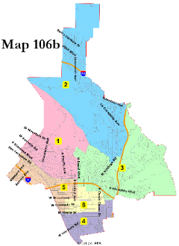
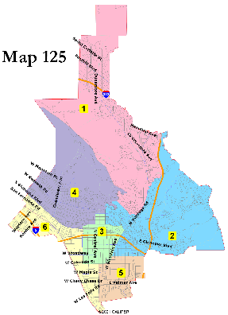
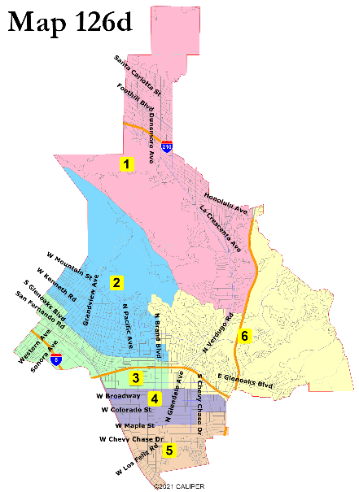
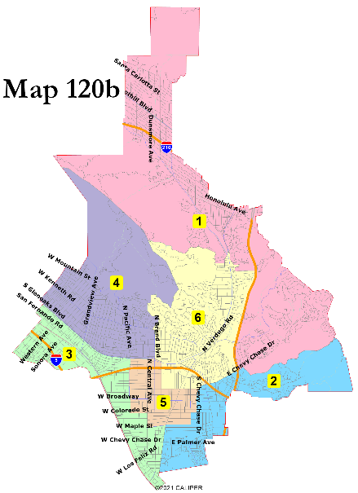
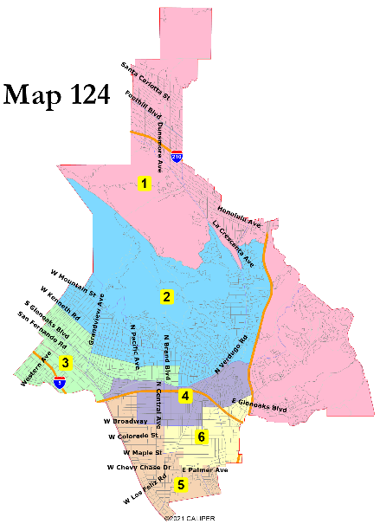
Maps Presented
Council’s three designated focus maps
Maps 104 and 120b also shown based on participant requests
Extensive use made of the interactive map to review the maps

Slide 8
General Awareness
Most participants had heard something about the issue, but were not participating nor following it.
Many questions about whether this would create a ‘strong Mayor’ or full-time Council, and whether this would change the Council – Manager form of government (answer: no).
Questions about whether the City is legally compelled to move to districts (answer: no).
Many questions about who picks a map, why is the map being drawn now, and if/when the map would be changed.
A few questions about the impact on current Councilmembers.
Some questions about 2015 vote and the College and School District changing to by-area elections and why the City did not change at the same time.
Compliments for city staff’s responsiveness and helpfulness (on all issues, not just districting).
Multiple groups expressed their appreciation for the outreach and invitation.

Slide 9
Specific Feedback
No formal organization position was taken by any stakeholder group, but some individuals did offer their preferences.

Slide 10
Individual Feedback on Districting
Concern that creating districts creates “fiefdoms” and isolates Councilmembers from citywide concerns.
Dividing the city is not the right answer to the City’s growth. Divisions lead to conflict, not agreement.
Districts may make sense some day, but now is not the time.
Opposition to this process: districts yes/no should be decided before maps are drawn and outreach conducted.
Concern about just having one representative (or two with the Mayor) to contact, instead of all five at-large.
Some concern about costs of districting and redistricting.
Concern about districts electing someone with only a few hundred votes.
Opposes expanding number of Councilmembers.
Running every two years for Mayor would be too expensive, but it is also unfair to only have the Mayor seat up on one election cycle every four years.
Supports districts due to neighborhood focus and size of the city – there is no race/ethnic basis to draw districts in Glendale.
Support for a rotational Mayor – a district with both the Mayor and a Councilmember would have an advantage.

Slide 11
Individual Specific Map Comments
Downtown business impacts the entire city – should it be isolated in one district?
Crescenta Highlands and Whiting Woods should be in the same district.
Whiting Woods is good being with either Verdugo Woodlands or with the Canyons.
Montecito Park shares more issues and concerns with the Canyons than with Verdugo Woodlands.
In Map 106b, districts 2 and 3 work well but district 5 should not divide downtown.
Adams Hill is better with neighboring areas than with Glenoaks Canyon.
Adams Hill shares more issues and concerns with the Canyons than with the areas to the immediate north and west.
Preference for map 126b as best for the entire city.
Important to avoid dividing neighborhood associations.
Verdugo Woodlands could be split – it shares issues and concerns with both Rossmoyne and with neighborhoods to its north.
Likes how Map 125 keeps downtown unified, as large-building condo/apartment residents have shared issues and neighborhood concerns.
Support for San Fernando Road-focused district such as map 125.
Opposition to long San Fernando Road-focused district from Forest Lawn to Burbank.
Supports how map 126d creates more diverse districts.

Slide 12
Other Groups Contacted
The following additional groups were contacted about holding meetings, but either declined or did not respond:
Armenian Assembly of America | Armenian Society of Los Angeles | Fern Lane HOA | Glenoaks Canyon HOA | Northwest Glendale Lions Club
Armenian American Chamber of Commerce | Armenian Union | GCC Political Science Department | Homenetmen Glendale Ararat Chapter | Pelanconi Estates HOA
Armenian Council of America | Armenian Youth Association of California | Glendale Association of Realtors | Hoover High School | Rotary Club of Glendale
Armenian Cultural Foundation | Chevy Chase Estates Association | Glendale Bar Association | Housing Rights Center | Royal Canyon Property Owner's Association
Armenian Educational Foundation | Clark Magnet High School | Glendale Chamber of Commerce | Kenneth Village Merchants Association | United Young Armenians
Armenian Engineers & Scientists of America | College Hills Community Association | Glendale Environmental Coalition | Korean Glendale Sister City Association | Verdugo Woodlands West HOA
Armenian General Benevolent Union | Committee for Armenian Students in Public Schools | Glendale High School | League of Women Voters of Burbank/Glendale | Veterans Coalition of Glendale & the Verdugos
Armenian National Committee - Glendale | Crescenta Highlands Neighborhood Association | Glendale Historical Society | Montecito Park Neighborhood Association | Wellness Works
Armenian National Committee of America - Western Region | Crescenta Valley Chamber | Glendale Kiwanis Club | Montrose Shopping Park Association | Women's Civic League of Glendale
Armenian Professional Society | Crescenta Valley High School | Glendale Sunrise Rotary | Montrose Verdugo City Chamber of Commerce | YMCA Glendale
Armenian Relief Society - Western Region | Deer Canyon/Oakmont Property Owners Assoc. | Glendale Tenants Union | Montrose-Verdugo-Sparr Heights Neighborhood Assoc. | YMCA of the Foothills
Armenian Rights Council of America | Downtown Glendale Association | Glen Knoll HOA | Neighborhood Legal Services of LA County | YWCA of Glendale

Slide 13
Draft Map Discussion
Which map do you prefer, and why?
Could some change improve that map?
Which map(s) do you dislike? Why?
Interactive Web Viewer

Slide 14
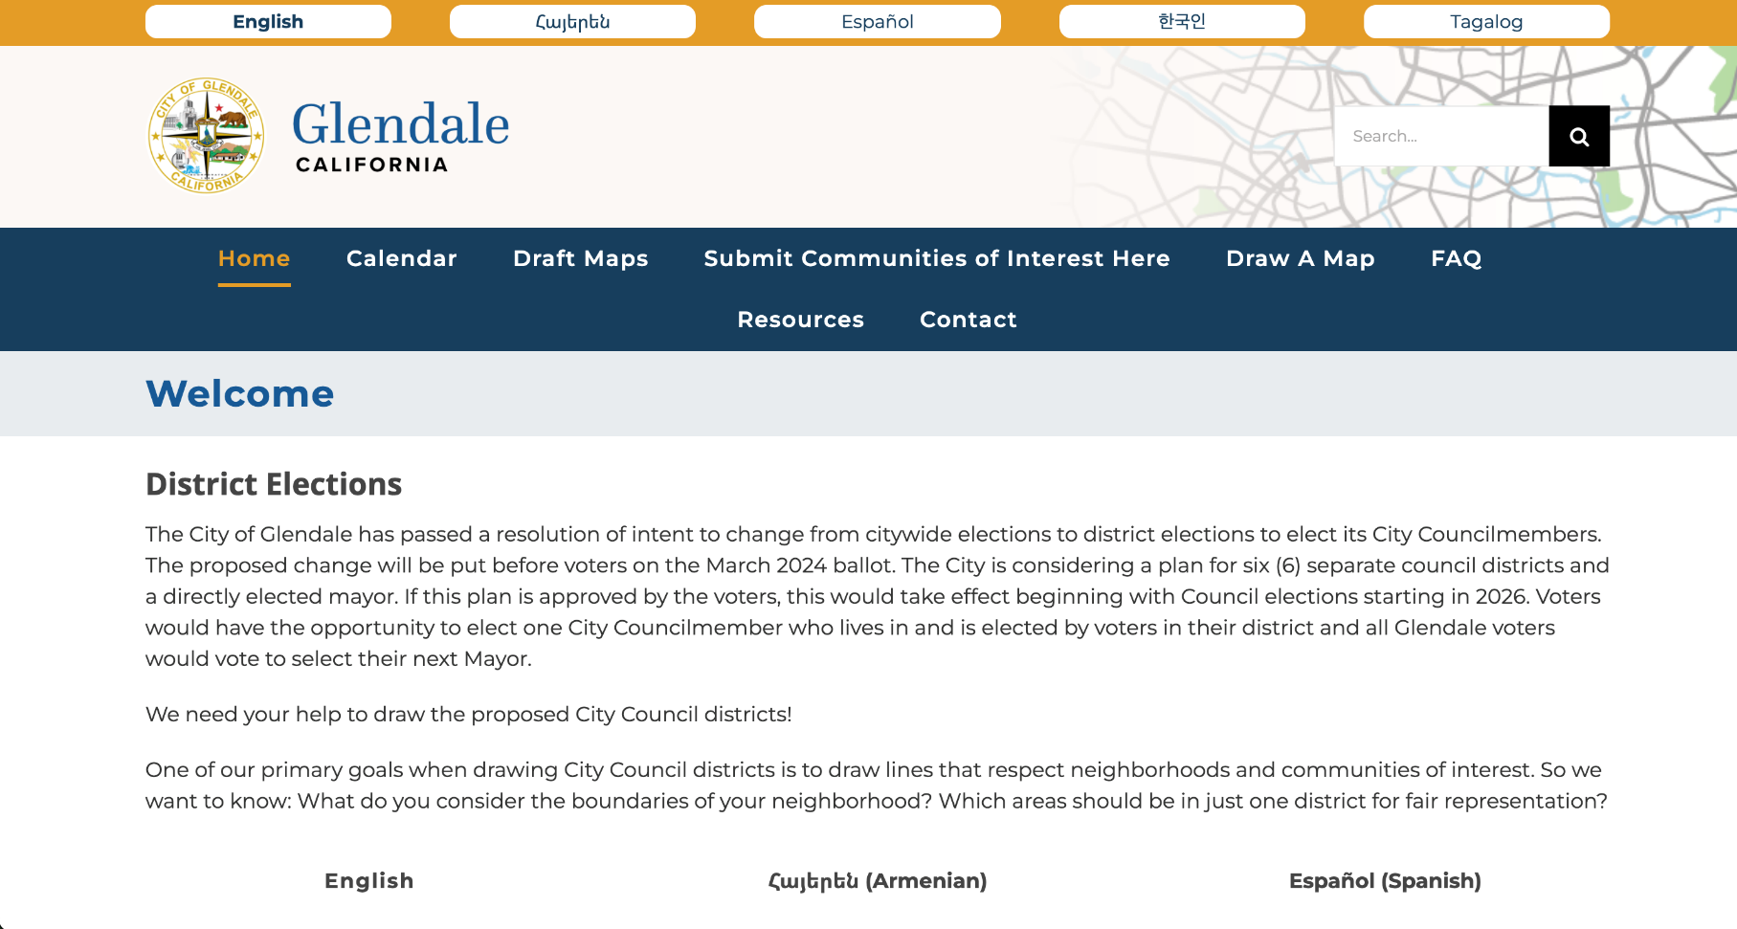
How to Stay Engaged
Website: MapGlendale.org |Phone: (818) 548-4844, ext. 1
Email: mapglendale@glendaleca.gov
Notes:
May update closer to workshop if the buttons are added to the top for translation.

